Slide 1
Introduction / Business Problem
The dataset contains collision data along with severity for each collision along with other datapoints associated with collision . The key attributes which are influential in determining a collision & its severity include
Weather
Road conditions
Light conditions
Speed
Location of collision
This solution will help ambulance & medical authorities to be prewarned before they reach the site of accident and make preparations based in advance .It will also help government authorities identify key aspects which cause high collision and prepare warnings , road improvements and other civic actions. For example knowing that a situation where its Raining with Wet road conditions , Dark lighting conditions /No Street Lights could increase severity of collision – the government and authorities could put warning displays in advance in awareness of such situations
.
Notes:
This is an example of a Text Slide. Reference the different layout options in the Slide Master (under the View tab) for different variations. Remember, our new Brand Guidelines call for clean and simple messages and design. Reference the PowerPoint Guidelines on the Brand Book for tips and useful information on creating effective presentations.

Slide 2
Data
Data: We will use the Coursera Capstone Collision data to make the analysis (https://s3.us.cloud-object-storage.appdomain.cloud/cf-courses-data/CognitiveClass/DP0701EN/version-2/Data-Collisions.csv) . There are a total of 37 data attributes and 194674 rows
The weather light & road conditions data will be used to predict the severity of the collision . This will be also accompanied by other criterion like location of accident , type of vehicles involved to predict the severity of collision
#For example an assumption could be that Raining with Wet road conditions , Dark lighting conditions /No Street Lights could increase severity of collision . Attributes like driver attention , influence of alcohol & drugs will also contribute to the severity of collision. All these parameters will contribute to the machine learning model. We will also conduct some statistical analysis to see parameters which have high correlation with the accident severity
Source : Data is recorded by Police dept & Traffic Records for seattle from 2004 to 2020

Slide 3
Methodology
Data cleaning
Removing missing values column wise
Removing missing values row wise
Changing categorical values to numerical ones
Exploratory data analysis: quantifying accidents by weather , road and day light conditions
Predicting severity with various machine learning algorithms

Slide 4
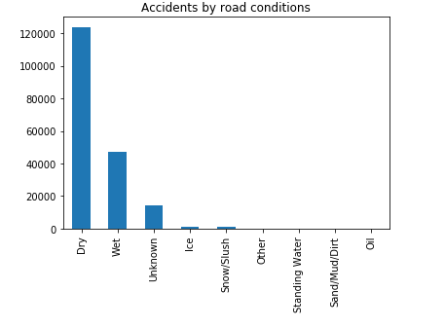
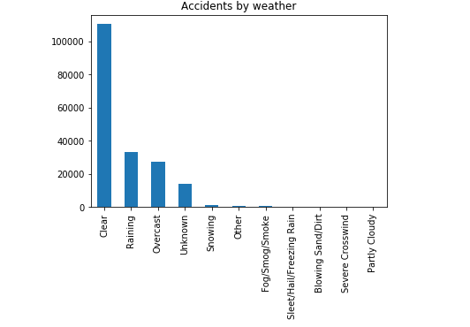
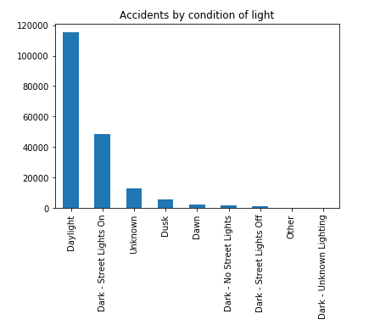
Exploratory Data Analysis

Slide 5
Model development
Split dataset into test set and train set
scikitlearn library
train set =80%, test set =20%, random_state=5
KNN model
n=5
Decision tree
k=5
Logistic Regression
C=0.1, solver type= default

Slide 6
Model Predictions

Slide 7
Results & Conclusion
KNN : F1 Score = 0.72
Logistic Regression : F1 Score = 0.7 , LogLoss = 0.53
DecisioN Tree : F1 - Score = 0.71
The model shows accuracy more than 70%
Exploratory data analysis shows that :
1. Accidents more frequent when road is dry versus other days
2.higher frequency when there is day light
3. Higher frequency when its a clear day
These inferences should be shared with drivers to reduce accidents.
Additionally the prediction model is fairly satisfactory which can help civic authorities and governments plan and communicate accordingly based on the inferences and use the models to prevent accidents.

